Slide 1
Quality Enhanced Fingerprinting System For skin diseased individuals
By
Shama Kamat
IST 659-Database Management System
Syracuse University, NY

Slide 2
Table of Contents
Major Database Functions
Collection/insertion
Access Privileges
Major Data Questions
ER Diagram
Forms
Reports
Function
Procedure
Trigger

Slide 3
Brief Description
This system will bridge the gap between healthcare, research industry and the biometric authentication industry
Two mechanisms with which fingerprints will be captured - Dactyloscopy microscope and electronic sensor or scanner
A few algorithms will be run for enhancing the image quality
A minutiae extraction algorithm is run over it to detect the minute details
This print can then be stored

Slide 4
Major Database Functions
Provide fingerprint with individual name and id to third-party biometric organizations like FBI
Provide patient data along with finger pictures for disease diagnosis and patient treatment
Diseases, fingerprints and minutiae can be used for research in the Biomedical Industry

Slide 5
Collection/Insertion
There occurs a check if there is an existent record, otherwise patient details can be entered through forms by FBI Agent to generate a fingerprint
This new patient will not be diagnosed, so doctor can diagnose the patient’s disease and enter the disease details through forms for the corresponding patient
Researcher can insert any new discovered disease in the Skin-Disease database

Slide 6
Access Privileges
FBI Agents, Doctors and Researchers, all can enter and query data specific to their roles
FBI Agents can add/view entire patient details except the patient disease. They can verify the fingerprint by checking for a match with any criminal fingerprints
Doctors can view all diagnosed patients, add/view their diseases and symptoms. They can also diagnose any new patient.
Researchers can research using patients diseases, symptoms, fingerprints and minutiae. They can also add new diseases

Slide 7
Major Data Questions
Is the skin-diseased individual a criminal or a safe individual?
Who are the diagnosed patients and what diseases and symptoms they had?
Who are the patients required diagnosis?
How many different diseases have a particular symptom?
Display full patient details with photo, finger photo and fingerprint for verification with passport.
What are the different minutiae belonging to a fingerprint? (form-sub form-slide 18)

Slide 8
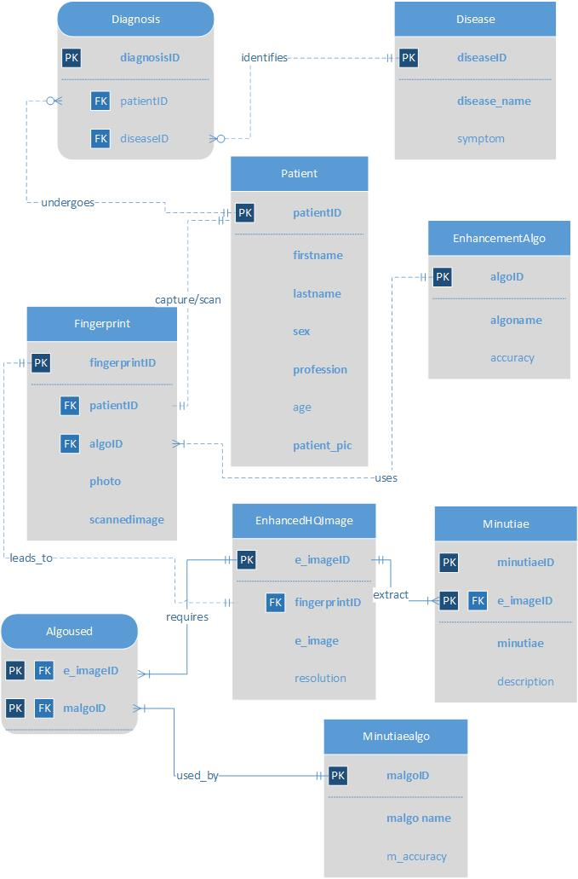
ERD-Visio

Slide 9
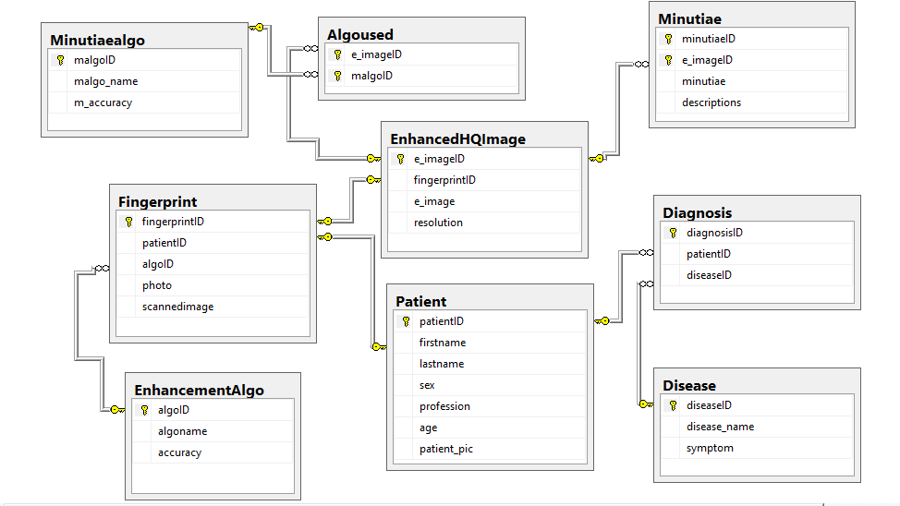
ERD-SQL

Slide 10
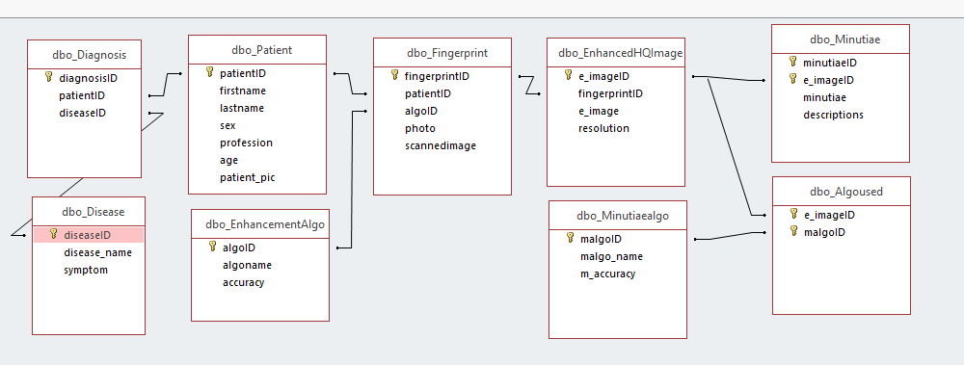
ERD-Access

Slide 11
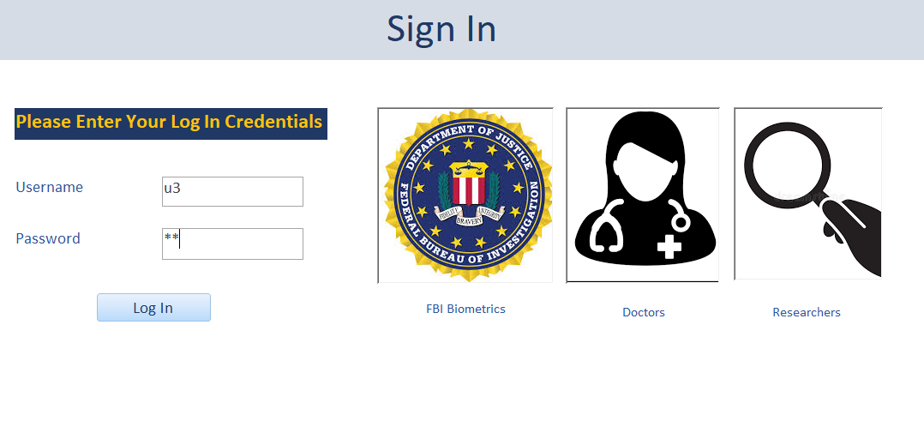
Forms

Slide 12
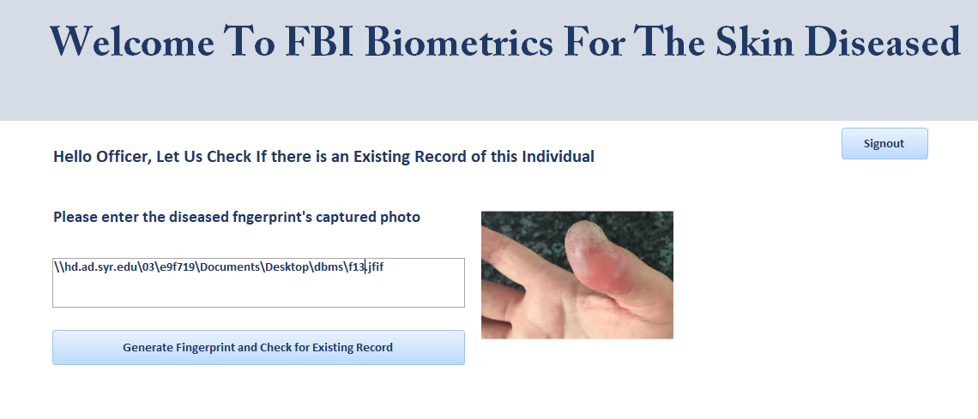
FBI Agent’s Welcome Page

Slide 13
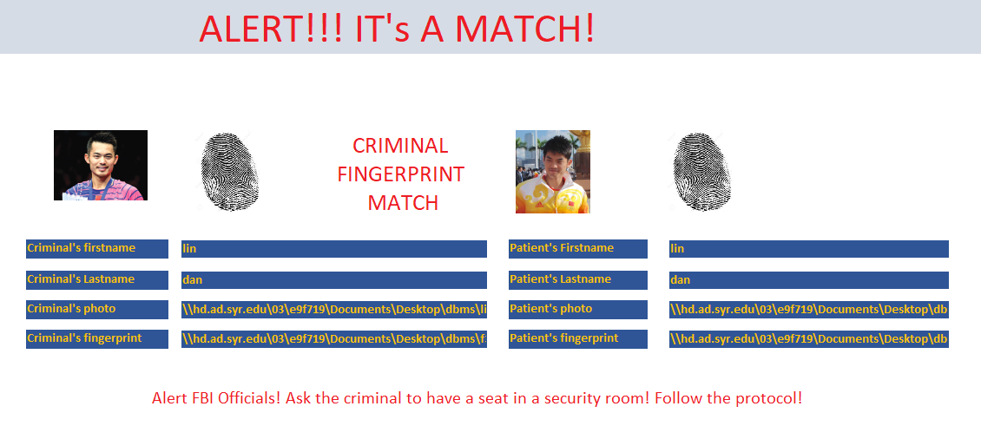
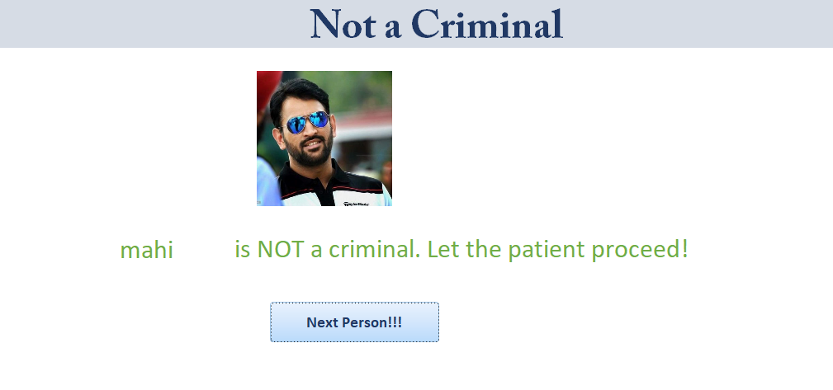

Slide 14
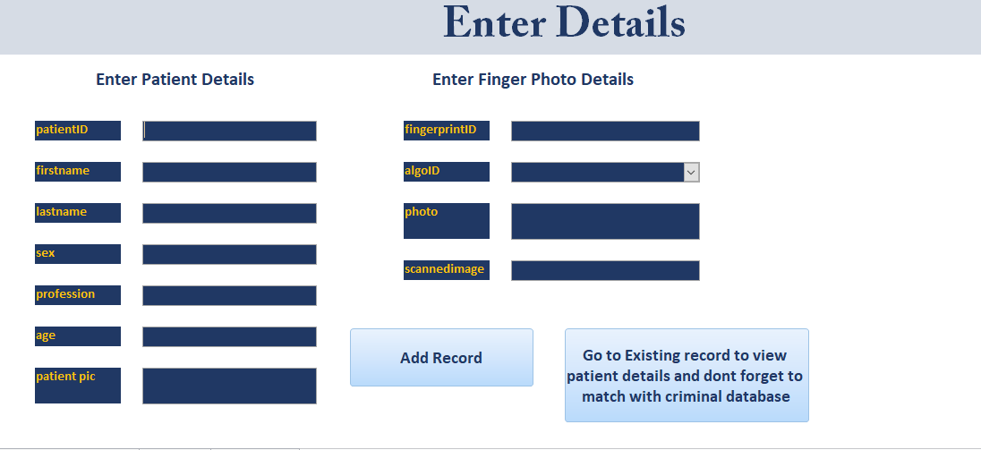
If no record exists, Agent enters information in Database through the following data entry form

Slide 15
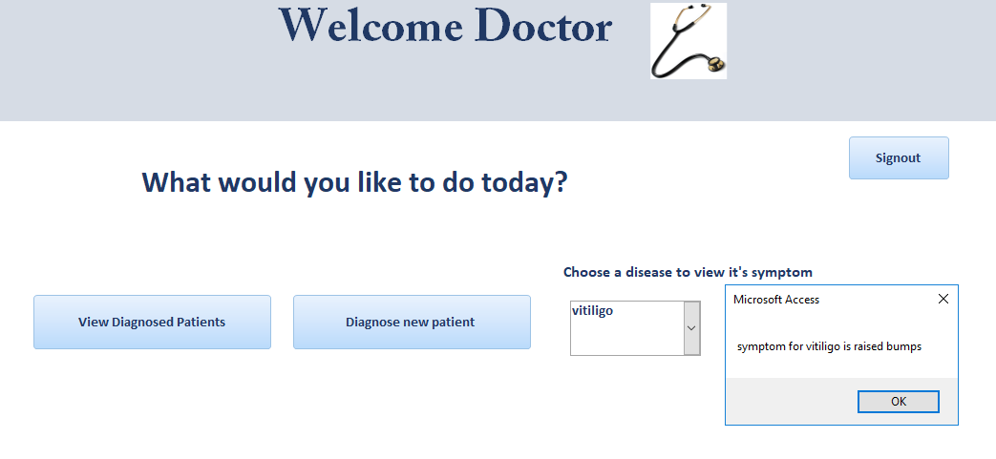
Welcome page for Doctor

Slide 16
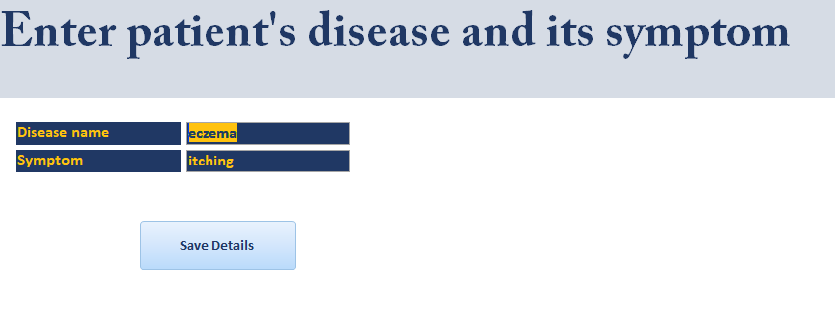
Data entry form for a non-diagnosed patient

Slide 17
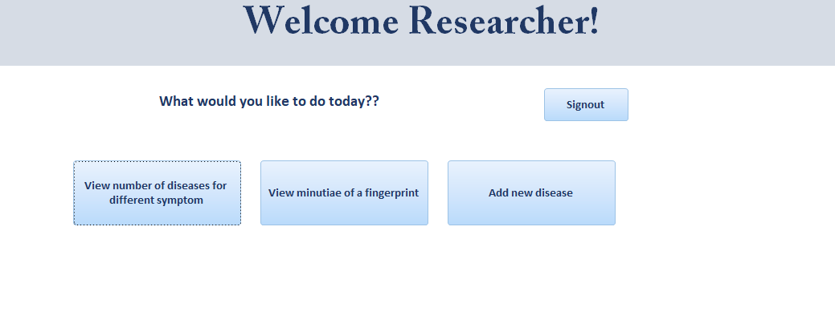
Welcome form for a Researcher

Slide 18
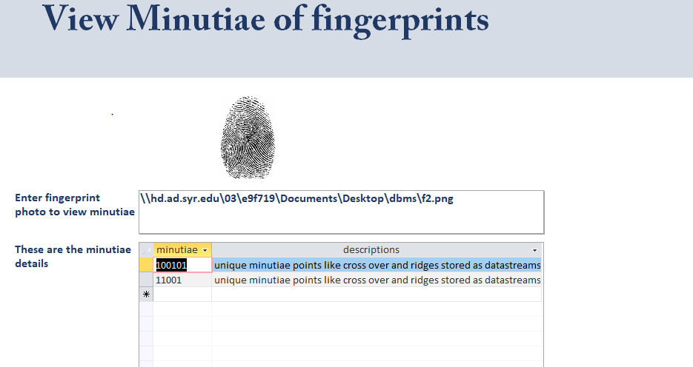
6. Sub form for viewing different minutiae of a fingerprint. This is the last major data question

Slide 19
Reports
Total reports=5
Reports I have Completed =5
These reports answer the first five major data questions respectively in the following slides

Slide 20
1. If the fingerprint matches with criminal fingerprint, a report is generated with existing criminal details and new details as claimed by the patient

Slide 21
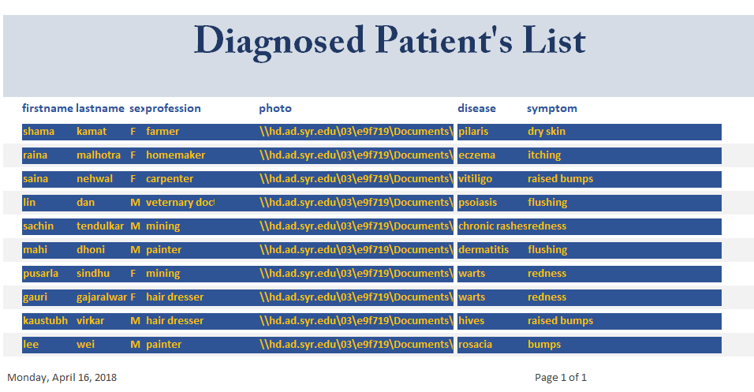
2. A doctor views all diagnosed patients, their diseases and symptoms

Slide 22
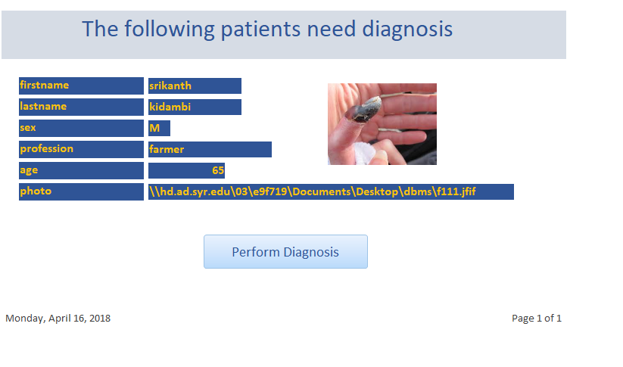
3. Doctor views who all still require diagnosis

Slide 23
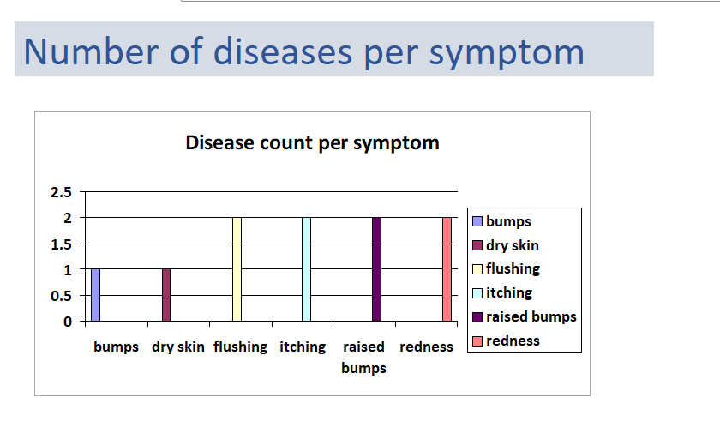
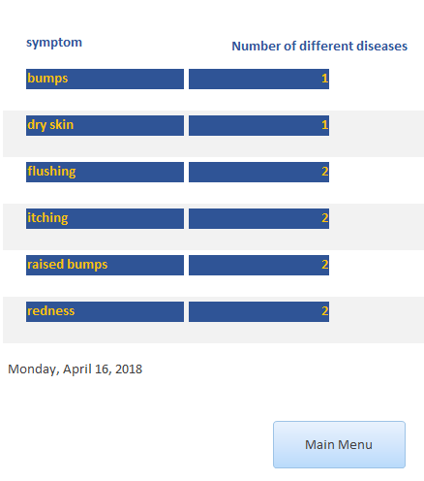
4. A researcher can view the number of diseases per symptom for data analysis

Slide 24
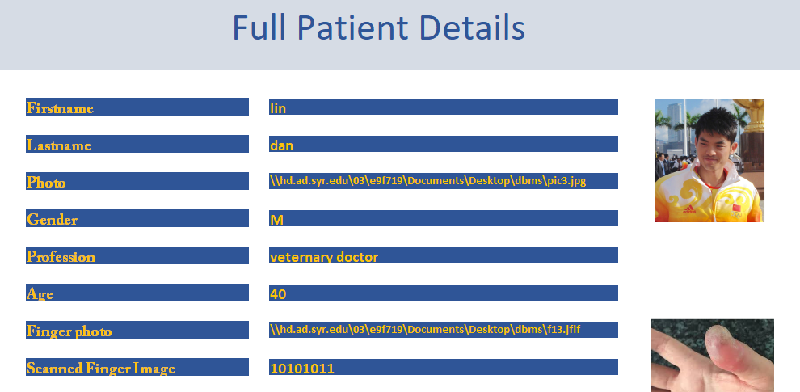
5. A FBI Agent can see full Patient details including photo, finger photo and the fingerprint

Slide 25
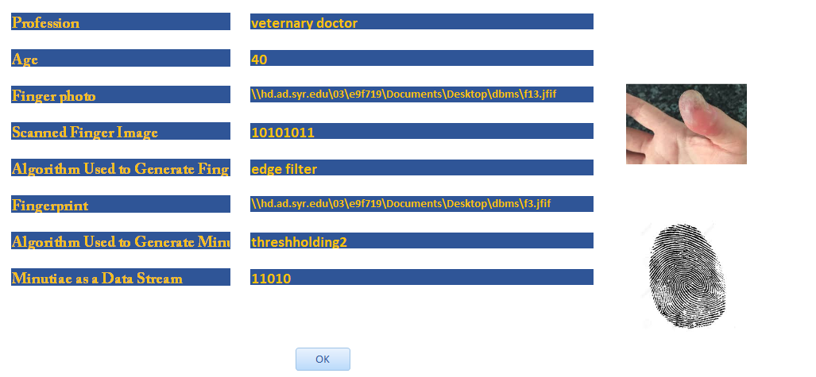
Continued..

Slide 26
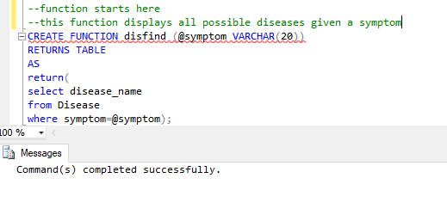
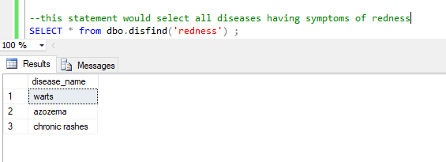
Function

Slide 27
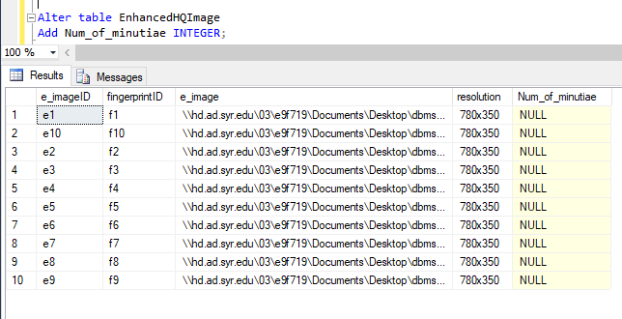
Procedure
Altered the table to add a column so as to add values through the procedure shown in next slide

Slide 28
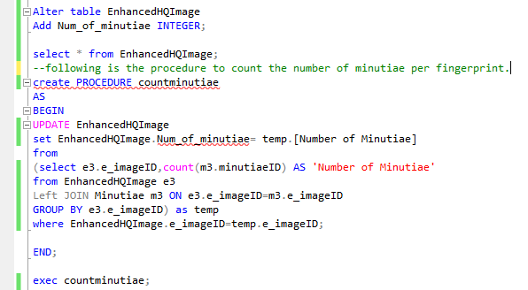
Procedure

Slide 29
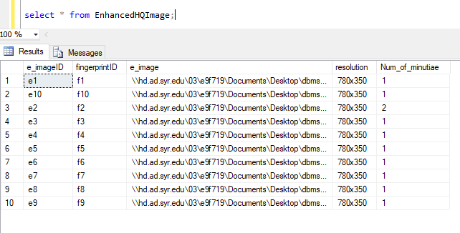
View Procedure results

Slide 30
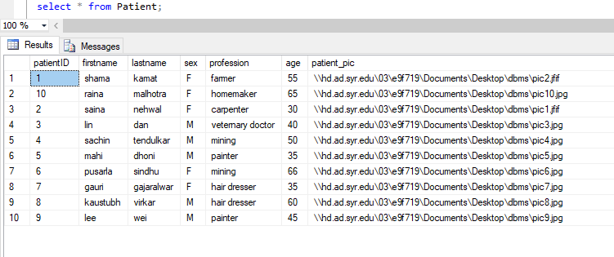
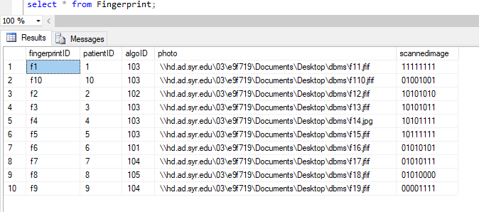
Before Trigger

Slide 31
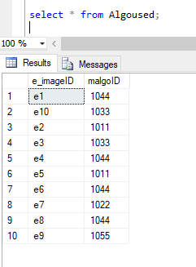
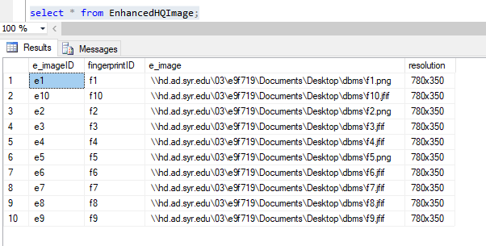
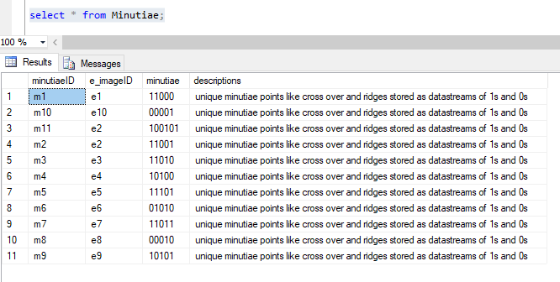

Slide 32
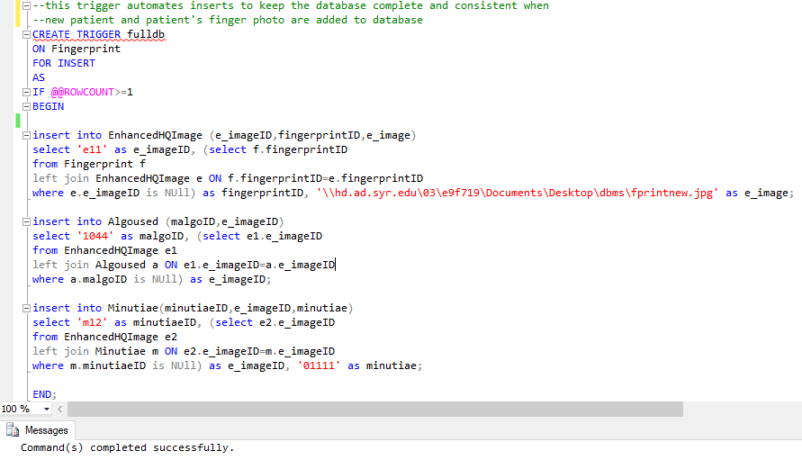
Trigger

Slide 33
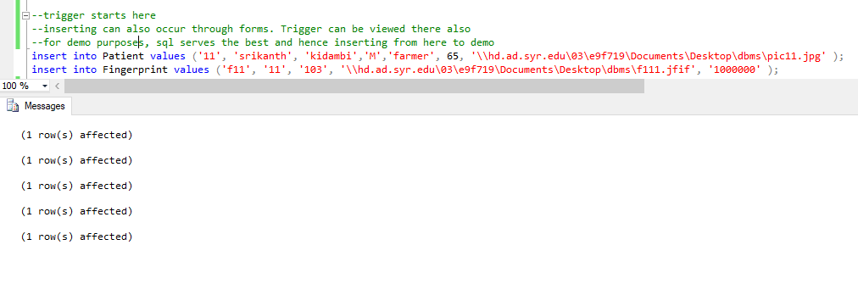
Insertion for Trigger Results

Slide 34
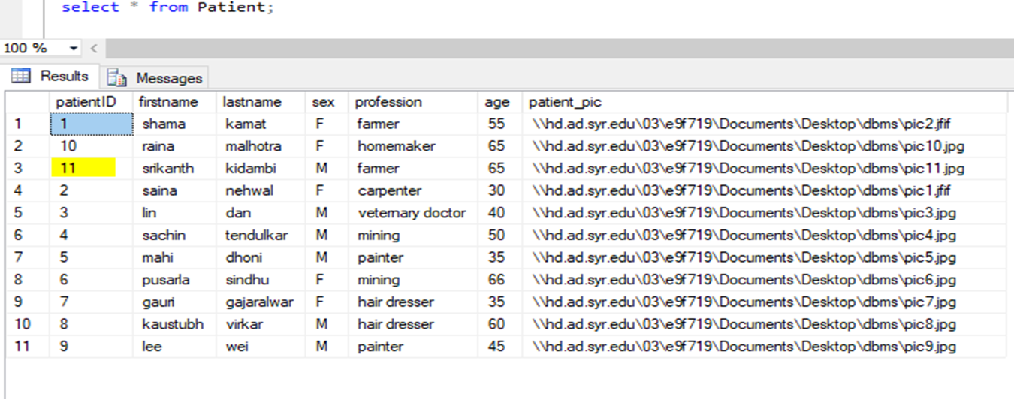
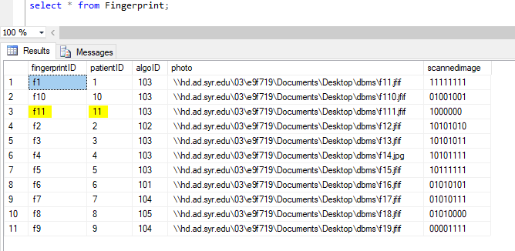
Insertion results

Slide 35
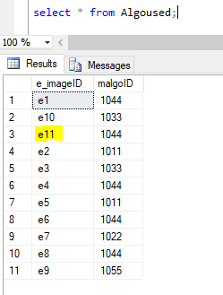
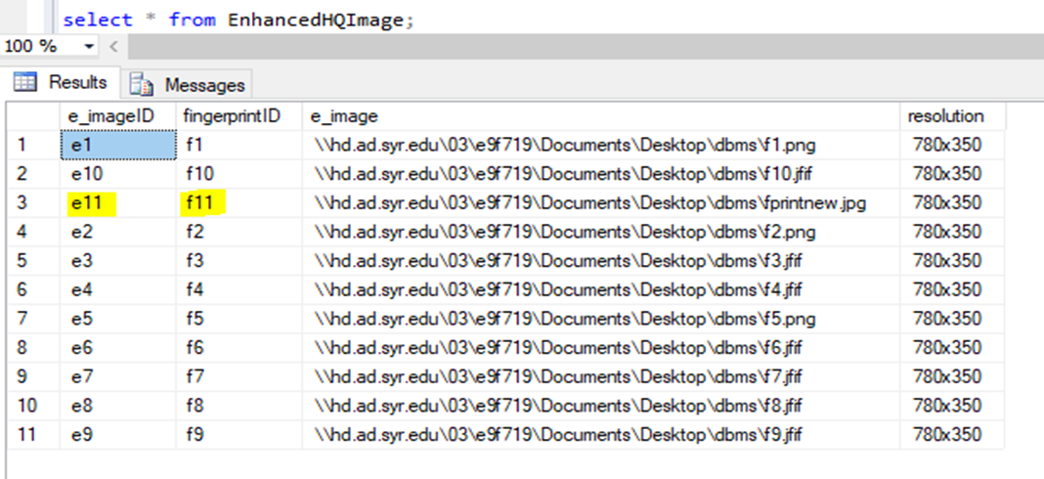
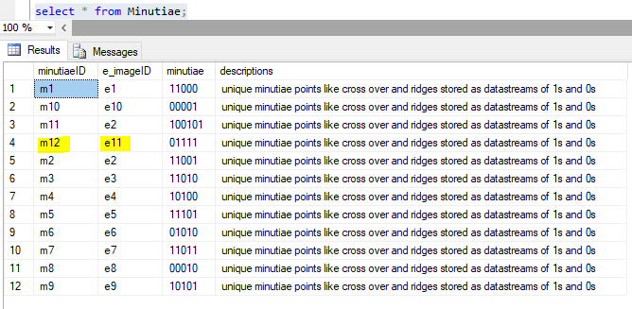
Highlighted changes occur because of Trigger

Slide 36
Thank you

